Slide 4
4-1 Statistical Inference
The field of statistical inference consists of those
methods used to make decisions or draw
conclusions about a population.
These methods utilize the information contained in
a sample from the population in drawing
conclusions.

Slide 5
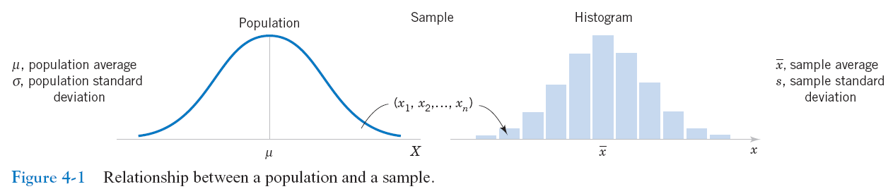
4-1 Statistical Inference

Slide 6
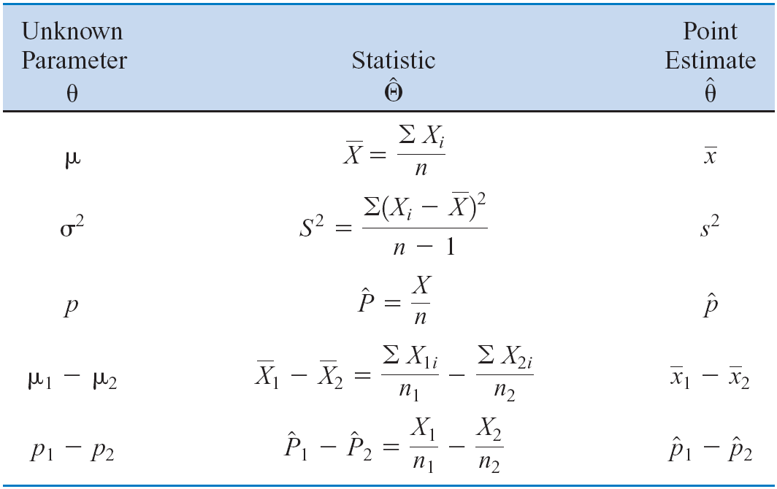
4-2 Point Estimation

Slide 7
4-2 Point Estimation

Slide 8
4-2 Point Estimation

Slide 9
4-3 Hypothesis Testing
4-3.1 Statistical Hypotheses
We like to think of statistical hypothesis testing as the data analysis stage of a comparative experiment, in which the engineer is interested, for example, in comparing the mean of a population to a specified value (e.g. mean pull strength).

Slide 10
4-3 Hypothesis Testing
4-3.1 Statistical Hypotheses
For example, suppose that we are interested in the burning rate of a solid propellant used to power aircrew escape systems.
Now burning rate is a random variable that can be described by a probability distribution.
Suppose that our interest focuses on the mean burning rate (a parameter of this distribution).
Specifically, we are interested in deciding whether or not the mean burning rate is 50 centimeters per second.

Slide 11
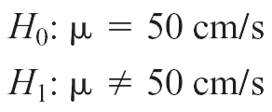
4-3 Hypothesis Testing
4-3.1 Statistical Hypotheses
Two-sided Alternative Hypothesis
One-sided Alternative Hypotheses

Slide 12
4-3 Hypothesis Testing
4-3.1 Statistical Hypotheses
Test of a Hypothesis
A procedure leading to a decision about a particular hypothesis
Hypothesis-testing procedures rely on using the information in a random sample from the population of interest.
If this information is consistent with the hypothesis, then we will conclude that the hypothesis is true; if this information is inconsistent with the hypothesis, we will conclude that the hypothesis is false.

Slide 13
4-3 Hypothesis Testing
4-3.2 Testing Statistical Hypotheses

Slide 14
4-3 Hypothesis Testing
4-3.2 Testing Statistical Hypotheses

Slide 15
4-3 Hypothesis Testing
4-3.2 Testing Statistical Hypotheses
Sometimes the type I error probability is called the significance level, or the α-error, or the size of the test.

Slide 16
4-3 Hypothesis Testing
4-3.2 Testing Statistical Hypotheses

Slide 17
4-3 Hypothesis Testing
4-3.2 Testing Statistical Hypotheses

Slide 18
4-3 Hypothesis Testing
4-3.2 Testing Statistical Hypotheses

Slide 19
4-3 Hypothesis Testing
4-3.2 Testing Statistical Hypotheses

Slide 20
4-3 Hypothesis Testing
4-3.2 Testing Statistical Hypotheses

Slide 21
4-3 Hypothesis Testing
4-3.2 Testing Statistical Hypotheses
The power is computed as 1 - β, and power can be interpreted as the probability of correctly rejecting a false null hypothesis. We often compare statistical tests by comparing their power properties.
For example, consider the propellant burning rate problem when
we are testing H ₀ : μ = 50 centimeters per second against H ₁ : μ not equal 50 centimeters per second . Suppose that the true value of the mean is μ = 52. When n = 10, we found that β = 0.2643, so the power of this test is 1 - β = 1 - 0.2643 = 0.7357 when μ = 52.

Slide 22
4-3 Hypothesis Testing
4-3.3 One-Sided and Two-Sided Hypotheses
Two-Sided Test:
One-Sided Tests:

Slide 23
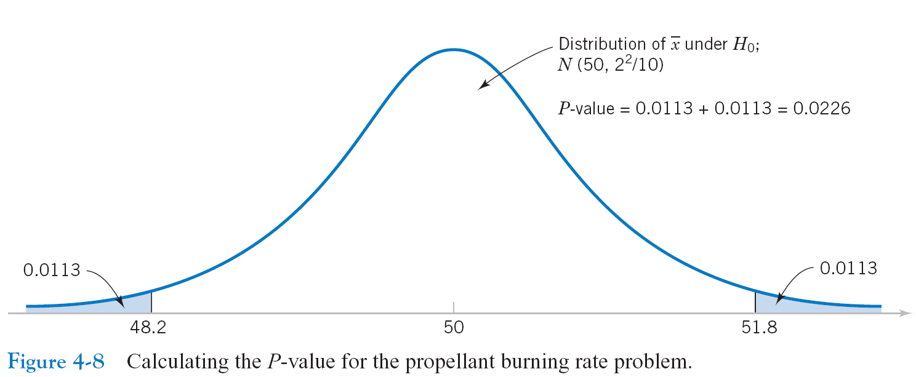
4-3 Hypothesis Testing
4-3.3 P-Values in Hypothesis Testing

Slide 24
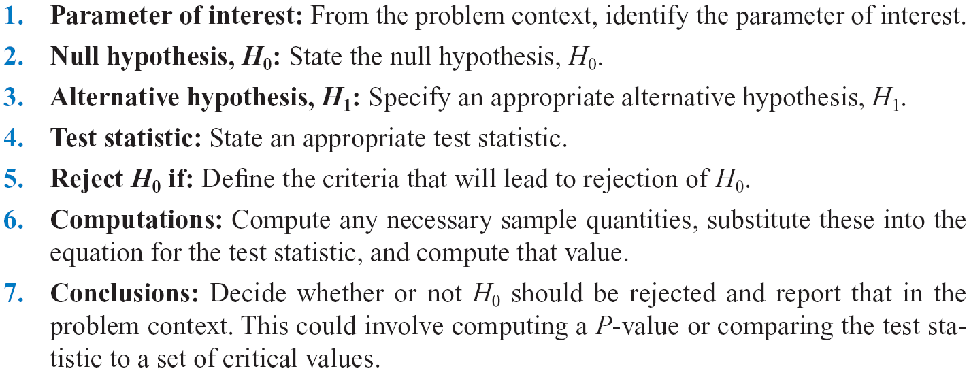
4-3 Hypothesis Testing
4-3.5 General Procedure for Hypothesis Testing

Slide 25
4-4 Inference on the Mean of a Population,
Variance Known
Assumptions

Slide 26
4-4 Inference on the Mean of a Population,
Variance Known
4-4.1 Hypothesis Testing on the Mean
We wish to test:
The test statistic is:

Slide 27
4-4 Inference on the Mean of a Population,
Variance Known
4-4.1 Hypothesis Testing on the Mean
Reject H₀ if the observed value of the test statistic z₀ is either:
or
Fail to reject H₀ if

Slide 28
4-4 Inference on the Mean of a Population,
Variance Known
4-4.1 Hypothesis Testing on the Mean

Slide 29
4-4 Inference on the Mean of a Population,
Variance Known
4-4.1 Hypothesis Testing on the Mean

Slide 30
4-4 Inference on the Mean of a Population,
Variance Known
4-4.2 Type II Error and Choice of Sample Size
Finding The Probability of Type II Error β

Slide 31
4-4 Inference on the Mean of a Population,
Variance Known
4-4.2 Type II Error and Choice of Sample Size
Sample Size Formulas

Slide 32
4-4 Inference on the Mean of a Population,
Variance Known
4-4.2 Type II Error and Choice of Sample Size
Sample Size Formulas

Slide 33
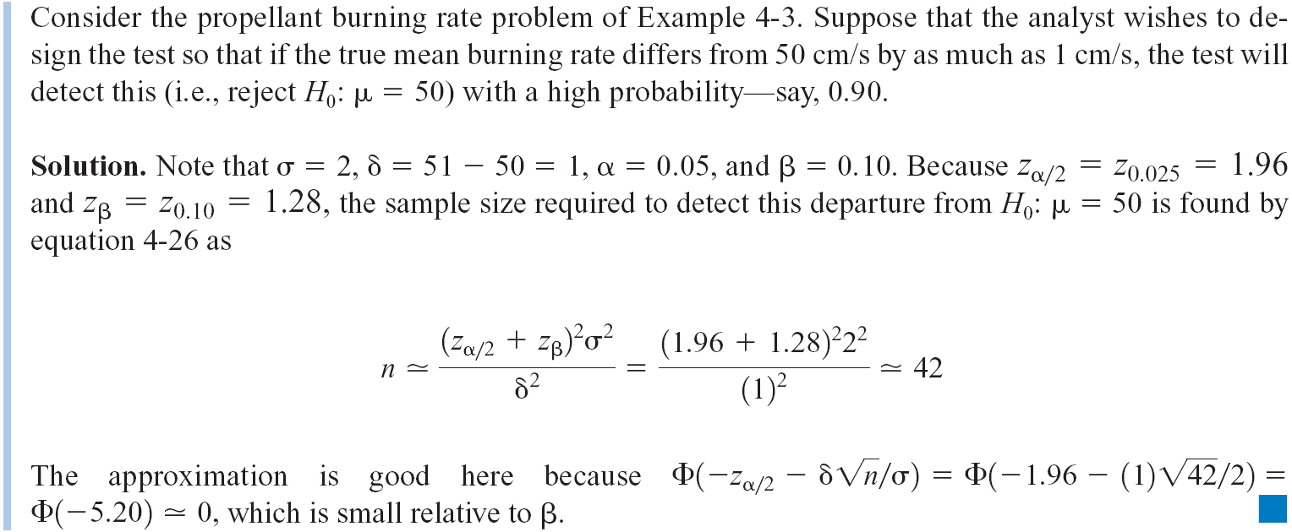
4-4 Inference on the Mean of a Population,
Variance Known
4-4.2 Type II Error and Choice of Sample Size

Slide 34
4-4 Inference on the Mean of a Population,
Variance Known
4-4.2 Type II Error and Choice of Sample Size

Slide 35
4-4 Inference on the Mean of a Population,
Variance Known
4-4.3 Large Sample Test
In general, if n ≥ 30, the sample variance s² will be close to σ² for most samples, and so s can be substituted for σ in the test procedures with little harmful effect.

Slide 36
4-4 Inference on the Mean of a Population,
Variance Known
4-4.4 Some Practical Comments on Hypothesis
Testing
The Seven-Step Procedure
Only three steps are really required:

Slide 37
4-4 Inference on the Mean of a Population,
Variance Known
4-4.4 Some Practical Comments on Hypothesis
Testing
Statistical versus Practical Significance

Slide 38
4-4 Inference on the Mean of a Population,
Variance Known
4-4.4 Some Practical Comments on Hypothesis
Testing
Statistical versus Practical Significance

Slide 39




4-4 Inference on the Mean of a Population,
Variance Known
4-4.5 Confidence Interval on the Mean
Two-sided confidence interval:
One-sided confidence intervals:
Confidence coefficient:

Slide 40
4-4 Inference on the Mean of a Population,
Variance Known
4-4.5 Confidence Interval on the Mean

Slide 41
4-4 Inference on the Mean of a Population,
Variance Known
4-4.6 Confidence Interval on the Mean

Slide 42
4-4 Inference on the Mean of a Population,
Variance Known
4-4.5 Confidence Interval on the Mean

Slide 43
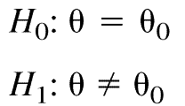
4-4 Inference on the Mean of a Population,
Variance Known
4-4.5 Confidence Interval on the Mean
Relationship between Tests of Hypotheses and Confidence Intervals
If [l,u] is a 100(1 - α) percent confidence interval for the parameter, then the test of significance level α of the hypothesis
will lead to rejection of H₀ if and only if the hypothesized value is not in the 100(1 - α) percent confidence interval [l, u].

Slide 44


4-4 Inference on the Mean of a Population,
Variance Known
4-4.5 Confidence Interval on the Mean
Confidence Level and Precision of Estimation
The length of the two-sided 95% confidence interval is
whereas the length of the two-sided 99% confidence
interval is

Slide 45
4-4 Inference on the Mean of a Population,
Variance Known
4-4.5 Confidence Interval on the Mean
Choice of Sample Size

Slide 46
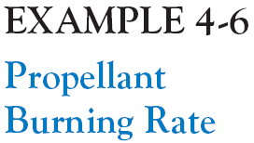
4-4 Inference on the Mean of a Population,
Variance Known
4-4.5 Confidence Interval on the Mean
Choice of Sample Size

Slide 47

4-4 Inference on the Mean of a Population,
Variance Known
4-4.5 Confidence Interval on the Mean
Choice of Sample Size

Slide 48
4-4 Inference on the Mean of a Population,
Variance Known
4-4.5 Confidence Interval on the Mean
One-Sided Confidence Bounds

Slide 49
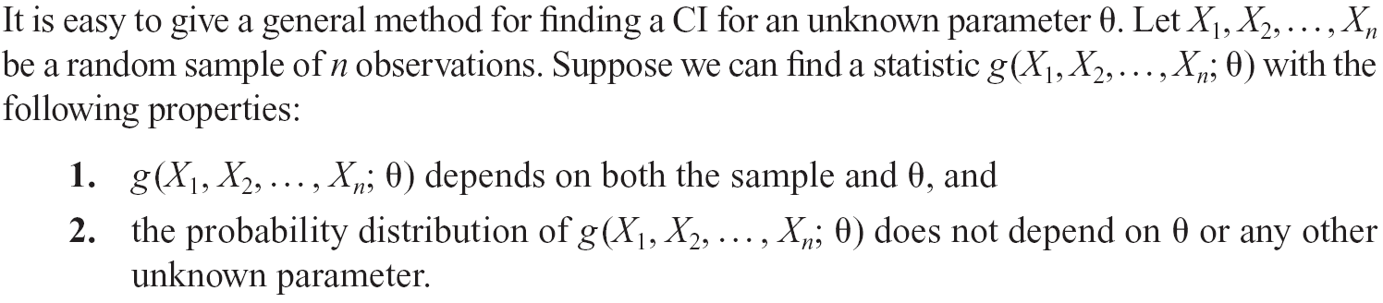
4-4 Inference on the Mean of a Population,
Variance Known
4-4.6 General Method for Deriving a Confidence Interval

Slide 50
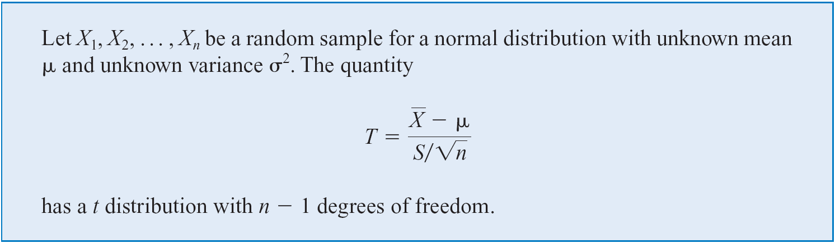
4-5 Inference on the Mean of a Population,
Variance Unknown
4-5.1 Hypothesis Testing on the Mean

Slide 51
4-5 Inference on the Mean of a Population,
Variance Unknown
4-5.1 Hypothesis Testing on the Mean

Slide 52
4-5 Inference on the Mean of a Population,
Variance Unknown
4-5.1 Hypothesis Testing on the Mean

Slide 53
4-5 Inference on the Mean of a Population,
Variance Unknown
4-5.1 Hypothesis Testing on the Mean
Calculating the P-value

Slide 54
4-5 Inference on the Mean of a Population,
Variance Unknown
4-5.1 Hypothesis Testing on the Mean

Slide 55
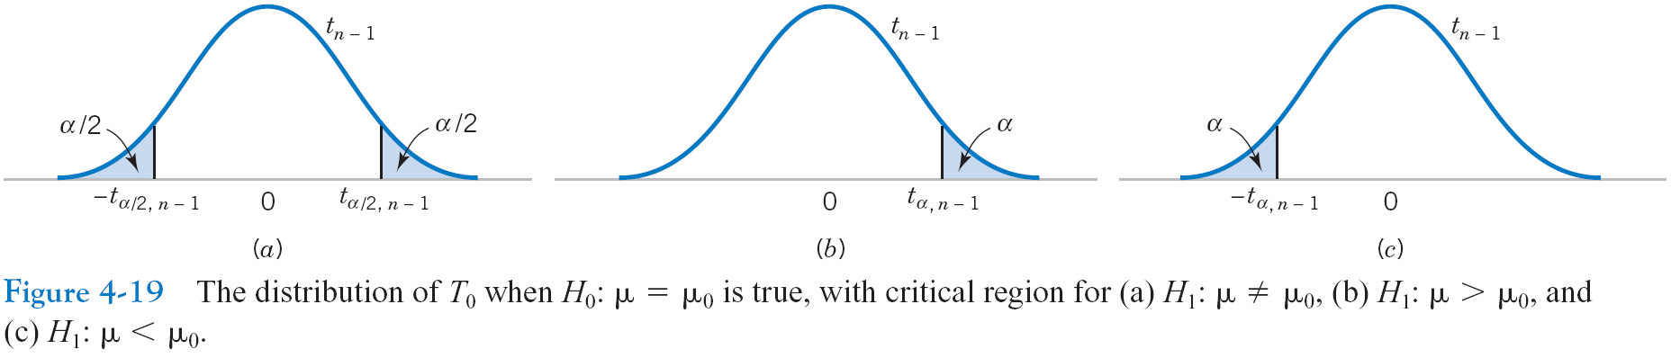
4-5 Inference on the Mean of a Population,
Variance Unknown
4-5.1 Hypothesis Testing on the Mean

Slide 56
4-5 Inference on the Mean of a Population,
Variance Unknown
4-5.1 Hypothesis Testing on the Mean

Slide 57
4-5 Inference on the Mean of a Population,
Variance Unknown
4-5.1 Hypothesis Testing on the Mean

Slide 58
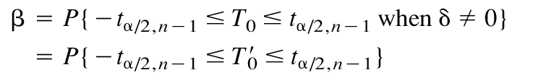
4-5 Inference on the Mean of a Population,
Variance Unknown
4-5.2 Type II Error and Choice of Sample Size
Fortunately, this unpleasant task has already been done, and the results are summarized in a series of graphs in Appendix A Charts Va, Vb, Vc, and Vd that plot for the t-test against a parameter δ for various sample sizes n.

Slide 59
4-5 Inference on the Mean of a Population,
Variance Unknown
4-5.2 Type II Error and Choice of Sample Size
These graphics are called operating characteristic (or OC) curves. Curves are provided for two-sided alternatives on Charts Va and Vb. The abscissa scale factor d on these charts is defined as

Slide 60
4-5 Inference on the Mean of a Population,
Variance Unknown
4-5.3 Confidence Interval on the Mean

Slide 61
4-5 Inference on the Mean of a Population,
Variance Unknown
4-5.3 Confidence Interval on the Mean

Slide 62
4-5 Inference on the Mean of a Population,
Variance Unknown
4-5.4 Confidence Interval on the Mean

Slide 63
4-6 Inference on the Variance of a
Normal Population
4-6.1 Hypothesis Testing on the Variance of a
Normal Population

Slide 64
4-6 Inference on the Variance of a
Normal Population
4-6.1 Hypothesis Testing on the Variance of a
Normal Population

Slide 65

4-6 Inference on the Variance of a
Normal Population
4-6.1 Hypothesis Testing on the Variance of a
Normal Population

Slide 66
4-6 Inference on the Variance of a
Normal Population
4-6.1 Hypothesis Testing on the Variance of a
Normal Population

Slide 67
4-6 Inference on the Variance of a
Normal Population
4-6.1 Hypothesis Testing on the Variance of a
Normal Population

Slide 68
4-6 Inference on the Variance of a
Normal Population
4-6.1 Hypothesis Testing on the Variance of a
Normal Population

Slide 69
4-6 Inference on the Variance of a
Normal Population
4-6.2 Confidence Interval on the Variance of a
Normal Population

Slide 70
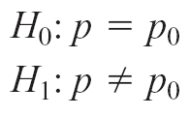
4-7 Inference on Population Proportion
4-7.1 Hypothesis Testing on a Binomial Proportion
We will consider testing:

Slide 71
4-7 Inference on Population Proportion
4-7.1 Hypothesis Testing on a Binomial Proportion

Slide 72
4-7 Inference on Population Proportion
4-7.1 Hypothesis Testing on a Binomial Proportion

Slide 73
4-7 Inference on Population Proportion
4-7.1 Hypothesis Testing on a Binomial Proportion

Slide 74
4-7 Inference on Population Proportion
4-7.2 Type II Error and Choice of Sample Size

Slide 75
4-7 Inference on Population Proportion
4-7.2 Type II Error and Choice of Sample Size

Slide 76
4-7 Inference on Population Proportion
4-7.3 Confidence Interval on a Binomial Proportion

Slide 77
4-7 Inference on Population Proportion
4-7.3 Confidence Interval on a Binomial Proportion

Slide 78
4-7 Inference on Population Proportion
4-7.3 Confidence Interval on a Binomial Proportion
Choice of Sample Size

Slide 79
4-8 Other Interval Estimates for a
Single Sample
4-8.1 Prediction Interval

Slide 80
4-8 Other Interval Estimates for a
Single Sample
4-8.2 Tolerance Intervals for a Normal Distribution

Slide 81
4-10 Testing for Goodness of Fit
So far, we have assumed the population or probability distribution for a particular problem is known.
There are many instances where the underlying distribution is not known, and we wish to test a particular distribution.
Use a goodness-of-fit test procedure based on the chi-square distribution.

Slide 82
